Slide 1
DS 4300
Document Databases &
MongoDB
Mark Fontenot, PhD
Northeastern University
Some material used with permission from Dr. Rachlin, with thanks!

Slide 2
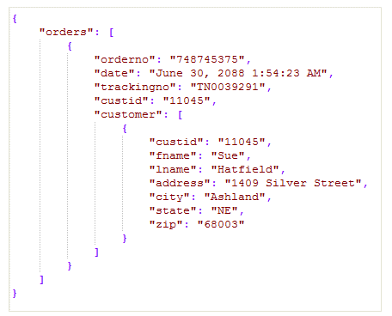
Document Database
A Document Database is a non-relational database that stores data as structured documents, usually in JSON.
They are designed to be simple, flexible, and scalable.

Slide 3
What is JSON?
JSON (JavaScript Object Notation)
a lightweight data-interchange format
It is easy for humans to read and write.
It is easy for machines to parse and generate.
JSON is built on two structures:
A collection of name/value pairs. In various languages, this is operationalized as an object, record, struct, dictionary, hash table, keyed list, or associative array.
An ordered list of values. In most languages, this is operationalized as an array, vector, list, or sequence.
These are two universal data structures supported by virtually all modern programming languages
Thus, JSON makes a great data interchange format.

Slide 4
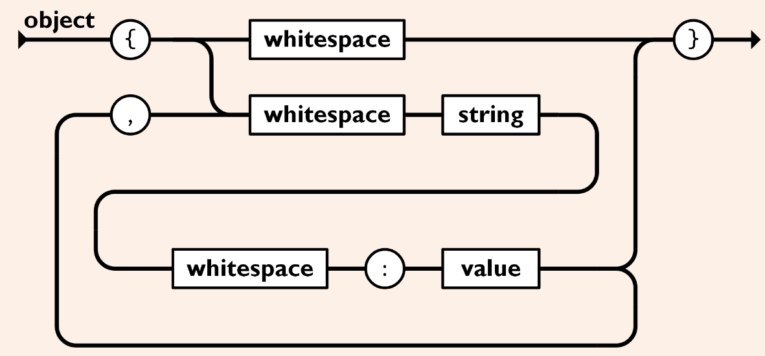
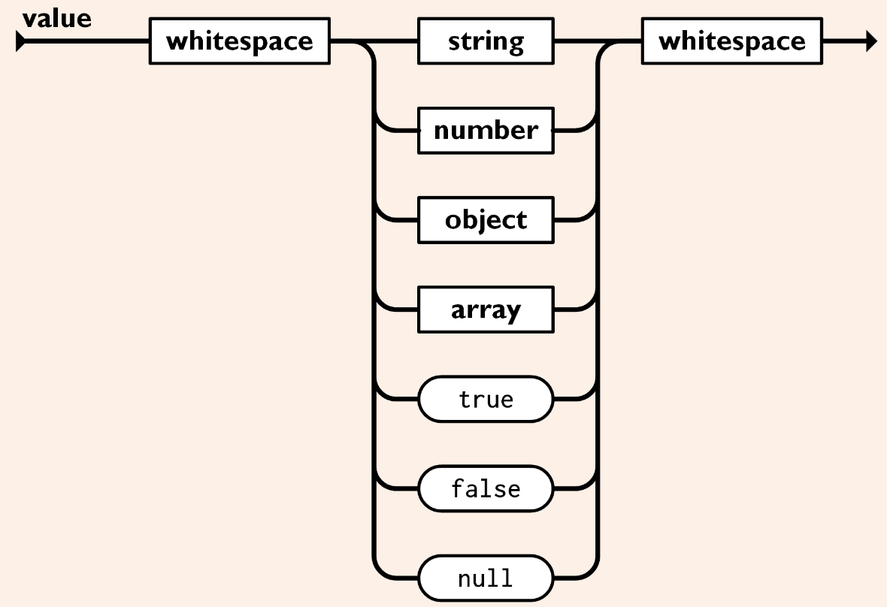
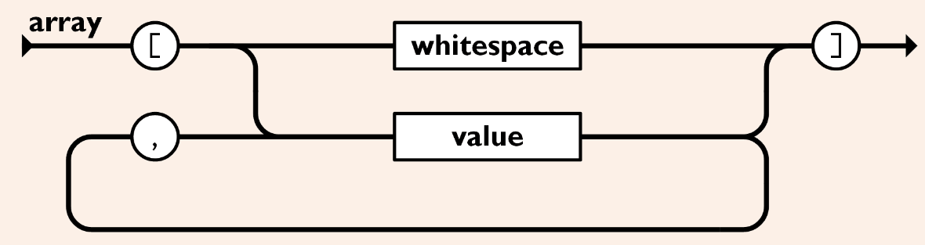
JSON Syntax
https://www.json.org/json-en.html

Slide 5
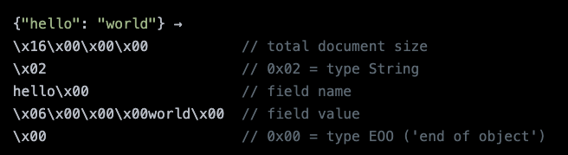
Binary JSON? BSON
BSON → Binary JSON
binary-encoded serialization of a JSON-like document structure
supports extended types not part of basic JSON (e.g. Date, BinaryData, etc)
Lightweight - keep space overhead to a minimum
Traversable - designed to be easily traversed, which is vitally important to a document DB
Efficient - encoding and decoding must be efficient
Supported by many modern programming languages

Slide 6
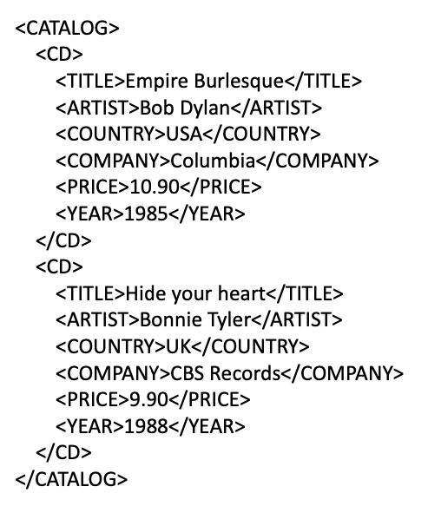
XML (eXtensible Markup Language)
Precursor to JSON as data exchange format
XML + CSS → web pages that separated content and formatting
Structurally similar to HTML, but tag set is extensible

Slide 7
XML-Related Tools/Technologies
Xpath - a syntax for retrieving specific elements from an XML doc
Xquery - a query language for interrogating XML documents; the SQL of XML
DTD - Document Type Definition - a language for describing the allowed structure of an XML document
XSLT - eXtensible Stylesheet Language Transformation - tool to transform XML into other formats, including non-XML formats such as HTML.

Slide 8
Why Document Databases?
Document databases address the impedance mismatch problem between object persistence in OO systems and how relational DBs structure data.
OO Programming → Inheritance and Composition of types.
How do we save a complex object to a relational database? We basically have to deconstruct it.
The structure of a document is self-describing.
They are well-aligned with apps that use JSON/XML as a transport layer

Slide 9
MongoDB

Slide 10
MongoDB
Started in 2007 after Doubleclick was acquired by Google, and 3 of its veterans realized the limitations of relational databases for serving > 400,000 ads per second
MongoDB was short for Humongous Database
MongoDB Atlas released in 2016 → documentdb as a service
https://www.mongodb.com/company/our-story

Slide 11
MongoDB Structure
Database
Collection A
Collection B
Collection C
Document 1
Document 1
Document 1
Document 2
Document 2
Document 2
Document 3
Document 3
Document 3

Slide 12
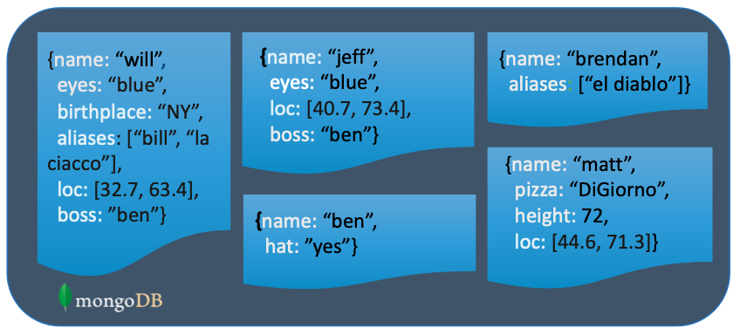
MongoDB Documents
No predefined schema for documents is needed
Every document in a collection could have different data/schema

Slide 13
Relational vs Mongo/Document DB
RDBMS | MongoDB
Database | Database
Table/View | Collection
Row | Document
Column | Field
Index | Index
Join | Embedded Document
Foreign Key | Reference

Slide 14
MongoDB Features
Rich Query Support - robust support for all CRUD ops
Indexing - supports primary and secondary indices on document fields
Replication - supports replica sets with automatic failover
Load balancing built in

Slide 15
MongoDB Versions
MongoDB Atlas
Fully managed MongoDB service in the cloud (DBaaS)
MongoDB Enterprise
Subscription-based, self-managed version of MongoDB
MongoDB Community
source-available, free-to-use, self-managed

Slide 16
Interacting with MongoDB
mongosh → MongoDB Shell
CLI tool for interacting with a MongoDB instance
MongoDB Compass
free, open-source GUI to work with a MongoDB database
DataGrip and other 3rd Party Tools
Every major language has a library to interface with MongoDB
PyMongo (Python), Mongoose (JavaScript/node), …

Slide 17
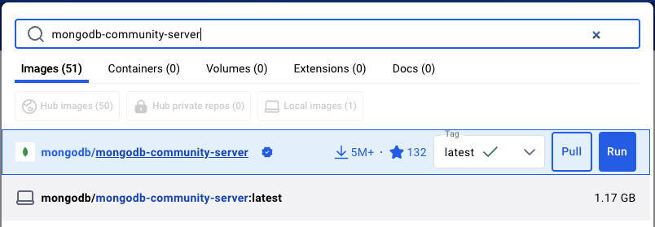
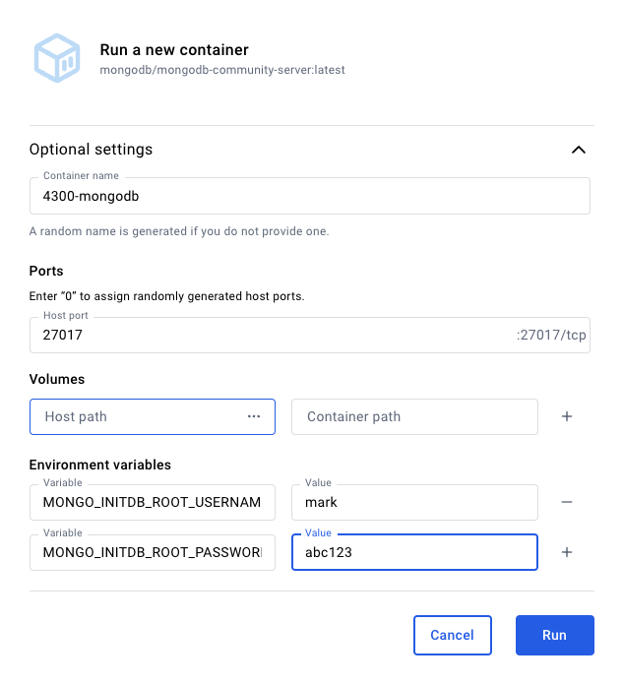
Mongodb Community Edition in Docker
Create a container
Map host:container port 27017
Give initial username and password for superuser
E
D

Slide 18
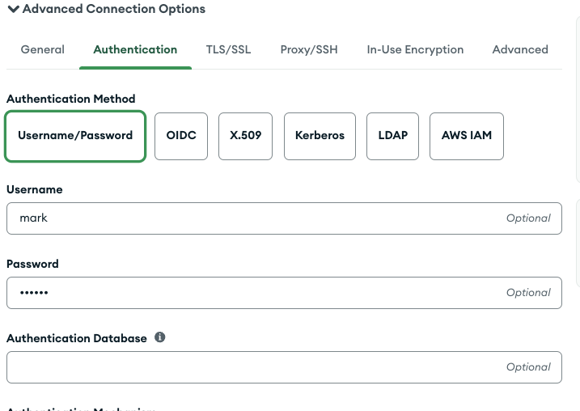
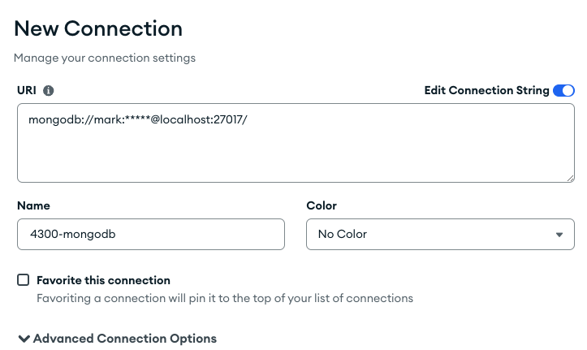
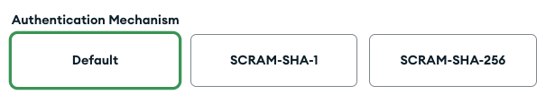

MongoDB Compass
GUI Tool for interacting with MongoDB instance
Download and install from > here <.

Slide 19
Load MFlix Sample Data Set
In Compass, create a new Database named mflix
Download mflix sample dataset and unzip it
Import JSON files for users, theaters, movies, and comments into new collections in the mflix database

Slide 20
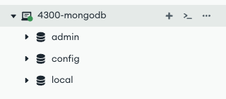
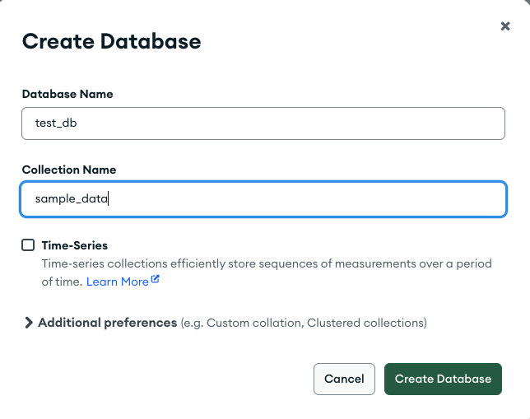
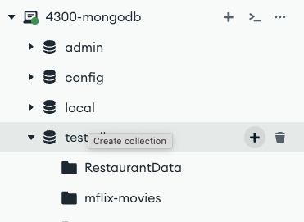
Creating a Database and Collection
To Create a new DB:
mflix
To Create a new Collection:
users

Slide 21
mongosh - Mongo Shell
find(...) is like SELECT
collection.find({ ____ }, { ____ })
filters projections

Slide 22
mongosh - find()
SELECT * FROM users;
use mflix
db.users.find()

Slide 23
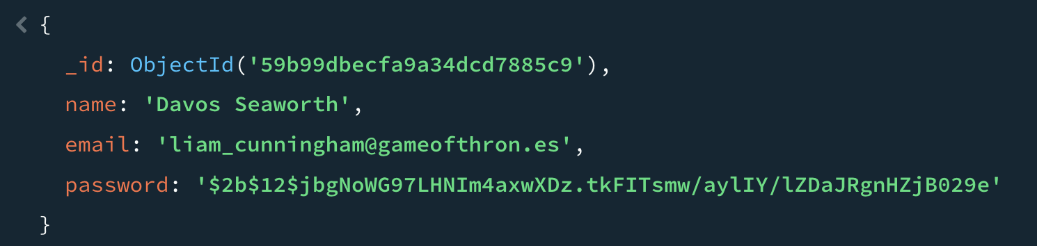
mongosh - find()
SELECT * FROM users WHERE name = “Davos Seaworth”;
filter
db.users.find({"name": "Davos Seaworth"})

Slide 24
mongosh - find()
SELECT * FROM movies WHERE rated in ("PG", "PG-13")
db.movies.find({rated: {$in:[ "PG", "PG-13" ]}})

Slide 25
mongosh - find()
Return movies which were released in Mexico and have an IMDB rating of at least 7
db.movies.find( {
"countries": "Mexico",
"imdb.rating": { $gte: 7 }
} )

Slide 26
mongosh - find()
Return movies from the movies collection which were released in 2010 and either won at least 5 awards or have a genre of Drama
db.movies.find( {
“year”: 2010,
$or: [
{ "awards.wins": { $gte: 5 } },
{ “genres”: "Drama" }
]
})

Slide 27
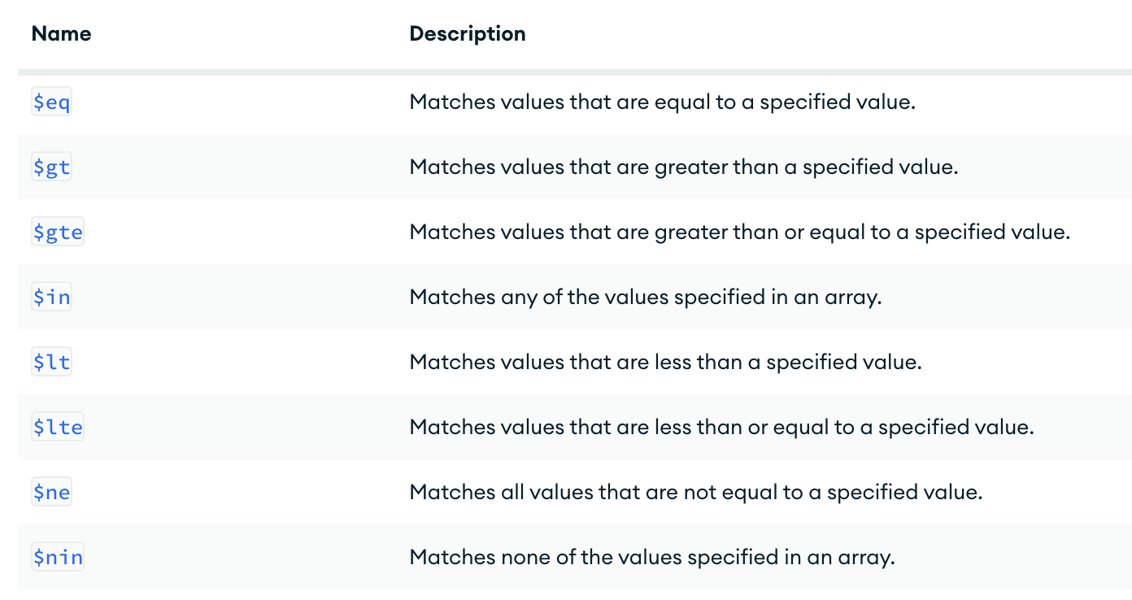
Comparison Operators

Slide 28
mongosh - countDocuments()
How many movies from the movies collection were released in 2010 and either won at least 5 awards or have a genre of Drama
db.movies.countDocuments( {
“year”: 2010,
$or: [
{ "awards.wins": { $gte: 5 } },
{ “genres”: "Drama" }
]
})

Slide 29
mongosh - project
Return the names of all movies from the movies collection that were released in 2010 and either won at least 5 awards or have a genre of Drama
db.movies.countDocuments( {
“year”: 2010,
$or: [
{ "awards.wins": { $gte: 5 } },
{ “genres”: "Drama" }
]
}, {“name”: 1, “_id”: 0} )
1 = return; 0 = don’t return

Slide 30
PyMongo

Slide 31
PyMongo
PyMongo is a Python library for interfacing with MongoDB instances
from pymongo import MongoClient
client = MongoClient(
‘mongodb://user_name:pw@localhost:27017’
)

Slide 32
Getting a Database and Collection
from pymongo import MongoClient
client = MongoClient(
‘mongodb://user_name:pw@localhost:27017’
)
db = client[‘ds4300’]
collection = db[‘myCollection’]

Slide 33
Inserting a Single Document
db = client[‘ds4300’]
collection = db[‘myCollection’]
post = {
“author”: “Mark”,
“text”: “MongoDB is Cool!”,
“tags”: [“mongodb”, “python”]
}
post_id = collection.insert_one(post).inserted_id
print(post_id)

Slide 34
Count Documents in Collection
SELECT count(*) FROM collection
demodb.collection.count_documents({})

Slide 35
??

